Slide 1

Community Development Funding
CITY OF LOWELL
DIVISION OF PLANNING AND DEVELOPMENT
Eliot Yaffa

Slide 2



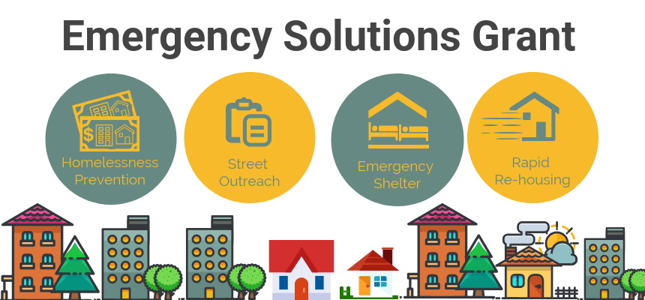
Programs Offered
The Division of Planning & Development is tasked with administering and monitoring the Community Development Block Grant (CDBG), Emergency Solutions Grant (ESG), and HOME program for the City of Lowell
Notes:
a grant from central government which a local authority can allocate to a wide range of services

Slide 3
History of CDBG, ESG & HOME
Program | CDBG | HOME | ESG
How Authorized? | Title I of the Housing and Community Development Act of 1974 | Title II of the Cranston-Gonzales Nation Affordable Housing Act | Part of the McKinney Vento Act signed into law in 1987
Why Authorized? | Combined 7 federal programs in order to better serve low-income communities. | “expand the supply of decent, safe sanitary, and affordable housing, with primary attention to rental housing for very- low income and low-income Americans.” | "The ESG program provides funding to: (1) engage homeless individuals and families living on the street; (2) improve the number and quality of emergency shelters for homeless individuals and families; (3) help operate these shelters; (4) provide essential services to shelter residents, (5) rapidly rehouse homeless individuals and families, and (6) prevent families/individuals from becoming homeless."
How funded? | State and designated entitlement communities (EC) | Participating Jurisdictions (individual communities or consortium of communities) | Money is provided to 196 Entitlement Communities not all CDBG funded EC have ESG funds
Notes:
This reform received bi-partisan support since it gave local and state municipalities decision-making powers on how to allocate funds as well as restricting the funds to only be disbursed on needs to assist low-income communities. These funds provided the tools necessary to combat the disinvestment happening in these communities by private capital.
Funding for CDBG is provided to entitlement communities and states. Entitlement communities receive 70% of the national allocation.
Funding for this program is distributed to communities or consortiums. The City of Framingham is a member of the WestMetro HOME Constorium administered by the City of Newton.

Slide 4
CDBG Entitlement Community
Lowell is an entitlement community (EC)
Population size is over 50,000
EC’s always receive funding from HUD
Annual allocation is the higher of these two formulas:
Lowell receives approximately $33 for every low- and moderate-income resident.
Formula A Weighted Factors | Formula B Weighted Factors
Population, Poverty #, Overcrowding | Population loss, poverty #, Pre-1940 housing
Notes:
Approximately 1,200 entitlement communities nationally . Communities don’t lose Entitlement Community Status only gain.
Framingham’s allocation is often lower than other Massachusetts communities.

Slide 5
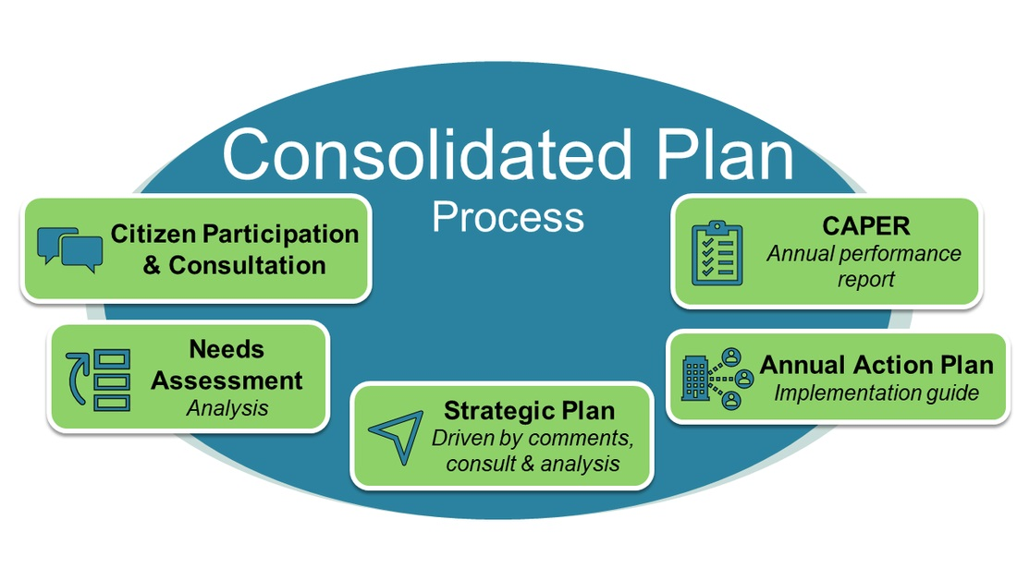
Grant Management requirements
The key requirements for receiving HUD funding are:
City needs to create a Community Development strategic plan (Consolidated Plan) every 5 years
Recently completed in July 2020
All activities undertaken must be consistent with the Consolidated Plan
City needs to create an annual action plan to determine how funds are allocated for the upcoming fiscal year
At the end of each year city needs to provide a report on the results of the program year (Consolidated Annual Performance and Evaluation Report (CAPER))
City must establish a Citizen Participation Plan and advertise public hearings.
Notes:
Part of the citizen action plan calls for the establishment of a Community Development Committee whose members decide on the allocation of CDBG funds
4 Public Hearings a year- Community needs assessment, CAPER, Annual Action Plan, Allocation of Funds

Slide 6
CDBG Eligible Programs
CDBG funding can only be used on activities that meet the following national objectives as identified by HUD and original legislation:
Provide a benefit to Low, Moderate-income residents
Prevent or eliminate slum/blight
Meet an urgent community need
Funded activities must be listed on the Consolidated Plan and Annual Action Plans
Project proposals are evaluated by CD staff initially and then by the project review to ensure that they meet all the criteria and best serve community needs.
Final allocation awards for public services are reviewed and recommended by this committee

Slide 7
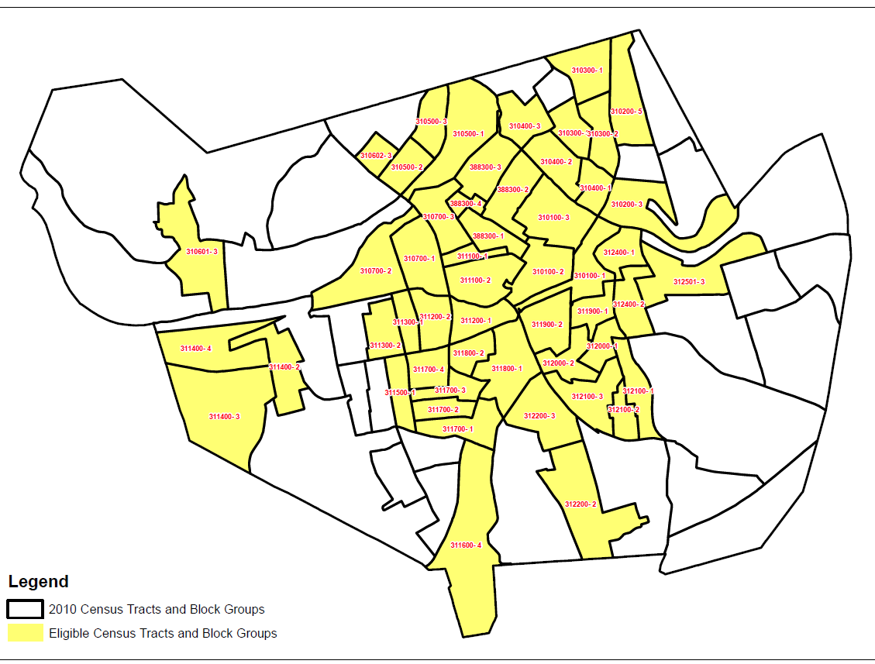
CDBG service Area
CDBG funds can only be used in service area where population is 51% low or moderate income (LMI) and primarily residential

Slide 8
CDBG Projects
Solicit Proposals
Proposal Presentations
CD Committee Evaluations
CD Committee Recom-mends Awards
City Council Approval
Sub-Recipient Contracts & Monitoring
CDBG Projects | Is amount capped?
Program Administration | Yes, 20% of allocation amount
Housing Rehab/ Code Enforcement | No
Public Services | 15% of allocation amount
Public Facilities | no
Economic Development | no
Notes:
CD staff solicits the grant and the CDC committee determines allocation amounts for public service projects. The public is invited to a public hear to hear the committee’s rationale to award funds. Administration funds are capped at 20% and public services capped at 15% of allocation amount. The general allocation is broken down into:
City council needs to approve final budget
Though the annual allocation is carefully budgeted sometimes projects fall through and staff turnover leads to unspent administrative funds. Recognizing the restrictions that make it challenging to spend sometimes HUD allows communities to roll over unspent funds. HUD requires previous years funds to be expended before using current award.
Though past program included loans for rehab and down payment assistance, which results in program income, current mortgages are payment deferred loans. These loans don’t require a monthly payment to the city but do require to be repaid back at 100% if the resident ceases to occupy that residence for the duration of the affordability period. Program income is used to calculate the administration and public service amounts for the following year.

Slide 9
HOME Program
City of Lowell receives approximately $900,000 annually
HOME funds are one of the only funding mechanisms for affordable housing development by the federal Government.
Majority of funds must be used to provide housing to earning up to 60% of the Area Median Income
Affordability period depends on how much funding is provided
HOME Projects | Is amount capped?
Program Administration | Yes, 25% of allocation amount
CHDO set aside | 15% of allocation amount

Slide 10
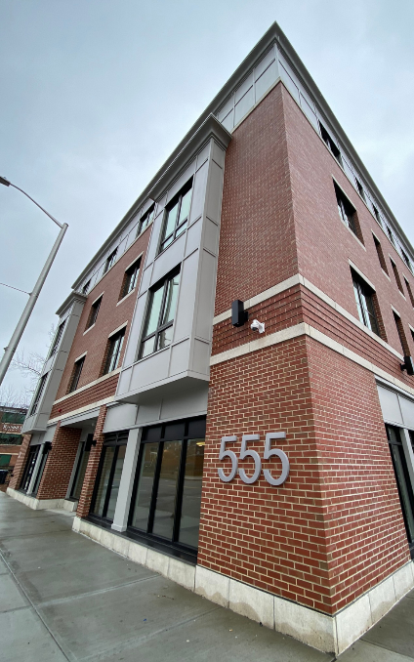

HOME Funded Projects
The city of Lowell currently allocates funds to 3 HOME eligible programs:
First Time Homebuyer Downpayment Assistance
Home Rehab
Rental Development
Edmands House

Slide 11
HOME Projects
First Time Homebuyer Program
HOME Rehab
Income Eligible Homeowners can get their home rehabbed
Rental Development
Funds can be used to assist developers to create affordable housing
Comprehensive Housing Inspection
Home needs to be brought up to code unlike CDBG funds where only some issues are rectified
Units are deed restricted
Funds can be used anywhere in Framingham
Maximum subsidy amount per development
Affordability Period is attached to the units
Affordability period can be up to 15 years
Homebuyers must have attended HUD certified housing counseling program
Assistance is capped
Units must meet passed Housing Quality Standards Inspection prior to closing
Notes:
Each program has its own requirements
Each has an income eligibility requirement - most have to be 60% area median income or lower
Here are some of the key distinctions
TBRA is one time – limited duration
Housing Rehab and Rental Development programs restrictions on how long a unit must remain affordable.

Slide 12
Emergency Solutions Grant Projects
One of the few funding mechanisms by HUD to prevent homelessness
$175,000 average annual allocation
Funding is restricted to organizations that coordinate with the Continuum of Care.
Notes:
CD staff solicits the grant and the CDC committee determines allocation amounts for public service projects. The public is invited to a public hear to hear the committee’s rationale to award funds. Administration funds are capped at 20% and public services capped at 15% of allocation amount. The general allocation is broken down into:
City council needs to approve final budget
Though the annual allocation is carefully budgeted sometimes projects fall through and staff turnover leads to unspent administrative funds. Recognizing the restrictions that make it challenging to spend sometimes HUD allows communities to roll over unspent funds. HUD requires previous years funds to be expended before using current award.
Though past program included loans for rehab and down payment assistance, which results in program income, current mortgages are payment deferred loans. These loans don’t require a monthly payment to the city but do require to be repaid back at 100% if the resident ceases to occupy that residence for the duration of the affordability period. Program income is used to calculate the administration and public service amounts for the following year.

Slide 13
ESG Projects
Solicit Proposals
Proposal Presentation
CD Committee Evaluations
CD Committee Recom-mends Awards
City Council Approval
Sub-Recipient Contracts & Monitoring
ESG Projects | Is amount
Program Administration | Yes, 7.5% of allocation amount
Emergency Shelter/ Street Outreach | 60%
Homeless Prevention | no
Rapid Rehousing | no
Notes:
CD staff solicits the grant and the CDC committee determines allocation amounts for public service projects. The public is invited to a public hear to hear the committee’s rationale to award funds. Administration funds are capped at 20% and public services capped at 15% of allocation amount. The general allocation is broken down into:
City council needs to approve final budget
Though the annual allocation is carefully budgeted sometimes projects fall through and staff turnover leads to unspent administrative funds. Recognizing the restrictions that make it challenging to spend sometimes HUD allows communities to roll over unspent funds. HUD requires previous years funds to be expended before using current award.
Though past program included loans for rehab and down payment assistance, which results in program income, current mortgages are payment deferred loans. These loans don’t require a monthly payment to the city but do require to be repaid back at 100% if the resident ceases to occupy that residence for the duration of the affordability period. Program income is used to calculate the administration and public service amounts for the following year.

Slide 14
Homeless Components
Emergency Shelter/ Street Outreach
Homeless Prevention
Rapid Rehousing

Slide 15
Emergency Shelter/ Street Outreach Eligible Activities
Essential services to unhoused population
Salaries for street outreach workers
Day shelter operations
Homeless shelter operations or renovation
Diversion services to prevent homelessness

Slide 16
Homeless Prevention Eligible Activities
Case management
Financial assistance to prevent homelessness within 14 days
Income limits apply

Slide 17
Rapid Rehousing Eligible Activities
Case management
Short to medium term rental assistance to obtain housing within 60 days

Slide 18
Statutory Requirements
CD enters into a contract with every sub-recipeint
Every project is subject to the following statutory requirements:
Environmental Review Conducted
Projects must have limited or no effect on wetlands, flood plains, endangered species or toxic substances
If applicable, Mass Historic Commission must review project details if property is over 50 years old
In addition, all public facility projects must ensure that local prevailing wages (Davis Bacon Act) are paid to all employees

Slide 19

Any questions

Slide 20

Eliot Yaffa
Director Of Community Development
Email: Eyaffa@lowellma.gov
50 Arcand Drive 2nd Floor, Lowell, MA 01852
Phone: 978-674-4252
Fax: 978-970-4262

